Slide 1
Meeting 2
Will Yuhang Li

Slide 2
Stimuli – Present/Absent Task
Attend: Pitch
Present : 3 (exist pitch)
Dual (nonexist word)
Attend: Word
Present: 1 (nonexist pitch)
Bean (exist word)
Both Attend Conditions
Absent: 1 (nonexist pitch)
Dual (nonexist word)
Sequence of pitch(number) and word
-3 -1 3 0
Boon Goose Bean Balm
Notes:
Force to focus on pitch, word has no information; Reason not confuse people

Slide 3
Stimuli – Same/Different Task (Pitch)
Attend: Pitch
Same: -3 -1 3 0 (same pitch)
Beam Dual Gall Boon (no same word at same loc)
Boon Beam (no repeating words)
Dif: -3 3 -1 0 (swapped pitch)
Beam Dual Gall Deam (no same word at same loc)
Boon Beam (no repeating words)
Sequence of pitch(number) and word
-3 -1 3 0
Boon Goose Bean Balm
Notes:
Same pitch, the work

Slide 4
Stimuli – Same/Different Task (Word)
Attend: Word
Same: -3 -2 (no repeating pitch)
-2 3 1 -1 (no same pitch at same loc)
Boon Goose Bean Balm (same words)
Dif: -3 -2 (no repeating pitch)
-2 3 1 -1 (no same pitch at same loc)
Goose Boon Bean Balm (swapped words)
Sequence of pitch(number) and word
-3 -1 3 0
Boon Goose Bean Balm
Notes:
Same pitch, the wor

Slide 5
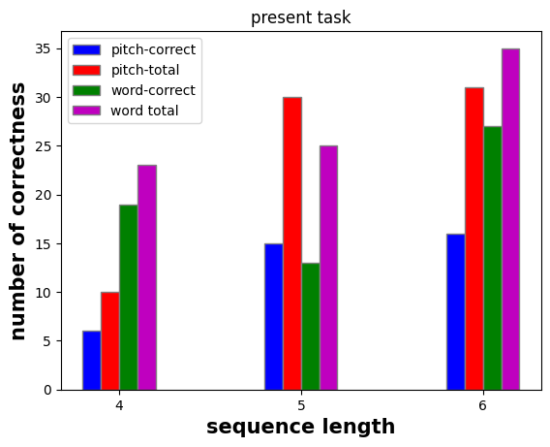
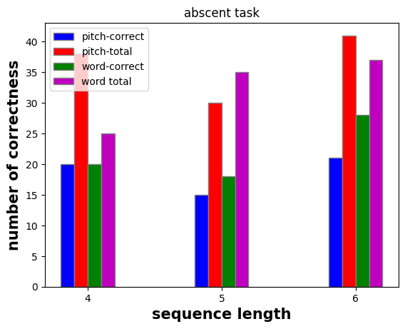
Correctness for Present & Absent Tasks

Slide 6
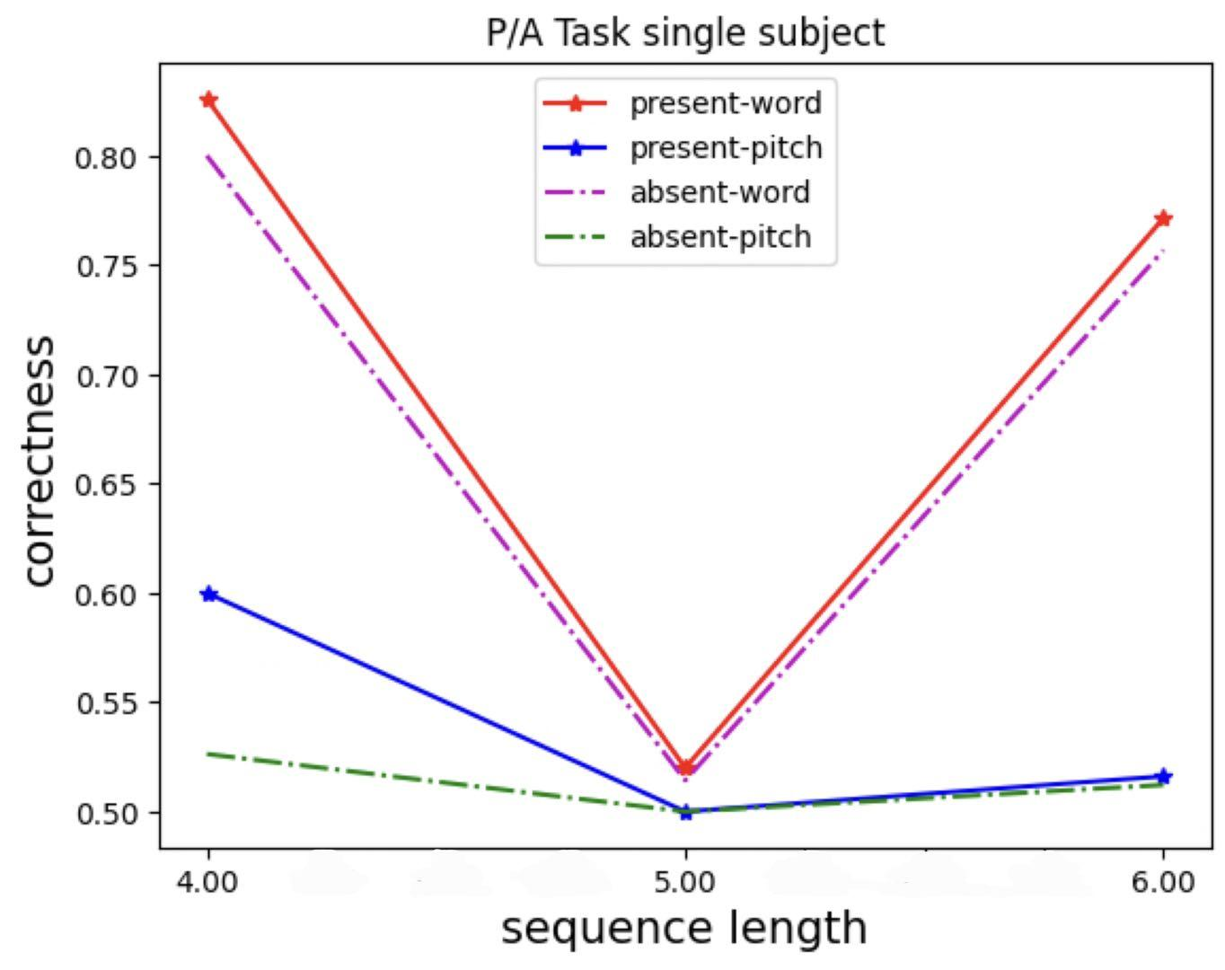
Correctness for Present & Absent Tasks
For P/A tasks, attending word have higher correctness.

Slide 7
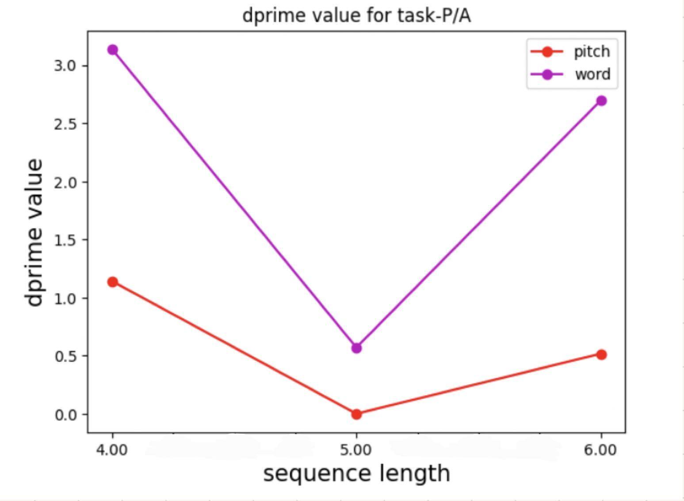
Dprime Values between Present & Absent task

Slide 8
Future
Plans
Complete S/D on Gorilla
Improve the flow of the experiment
Collect more data
Analysis data with other methods

